Slide 1


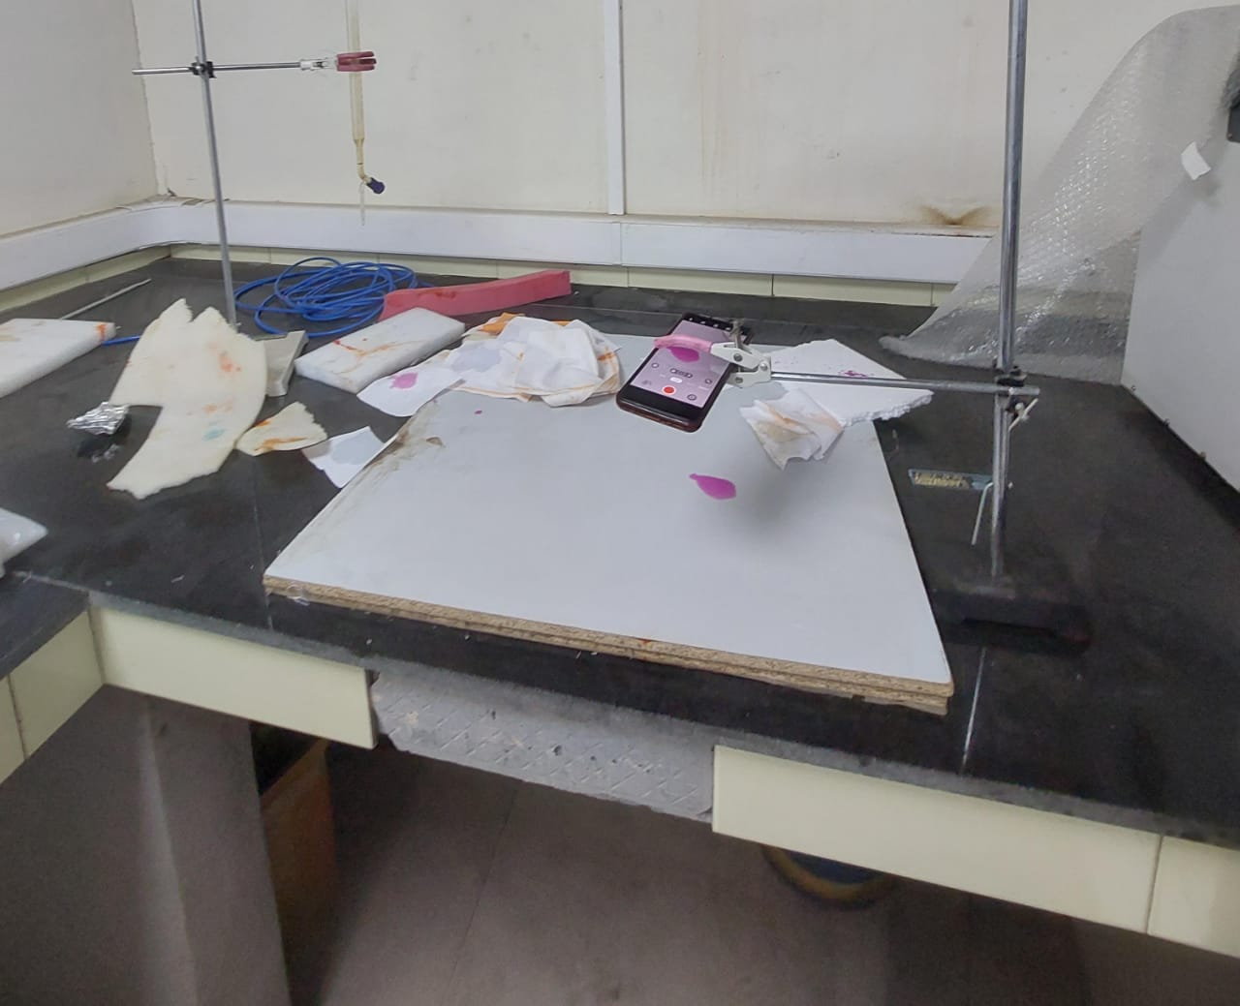
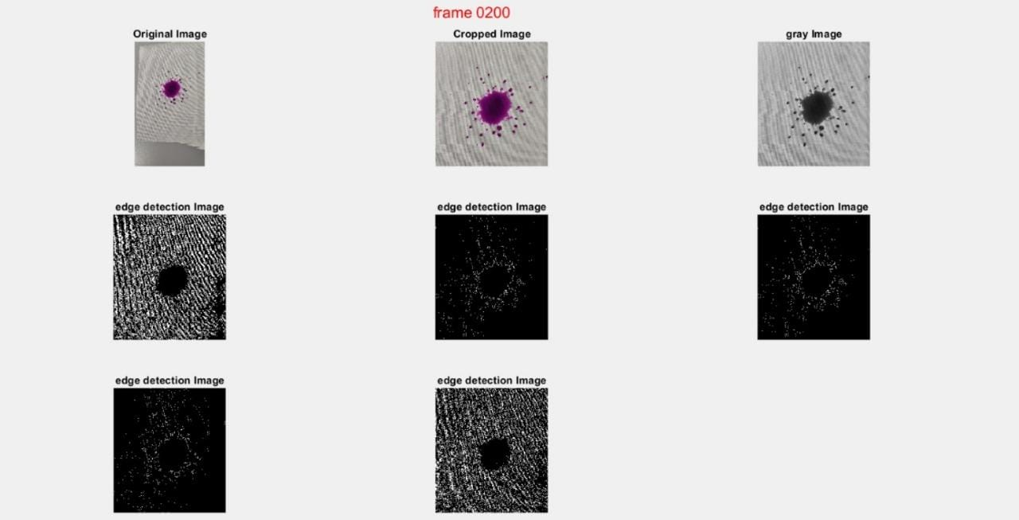
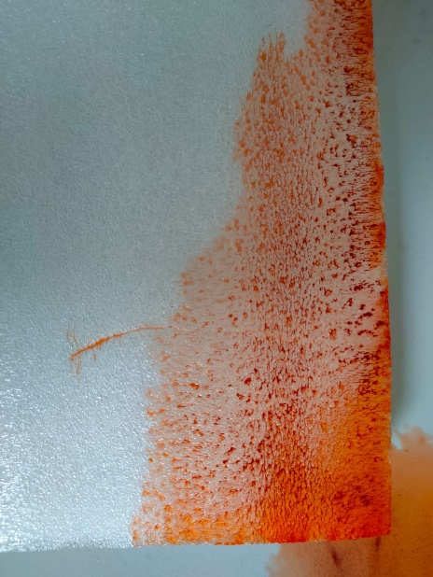
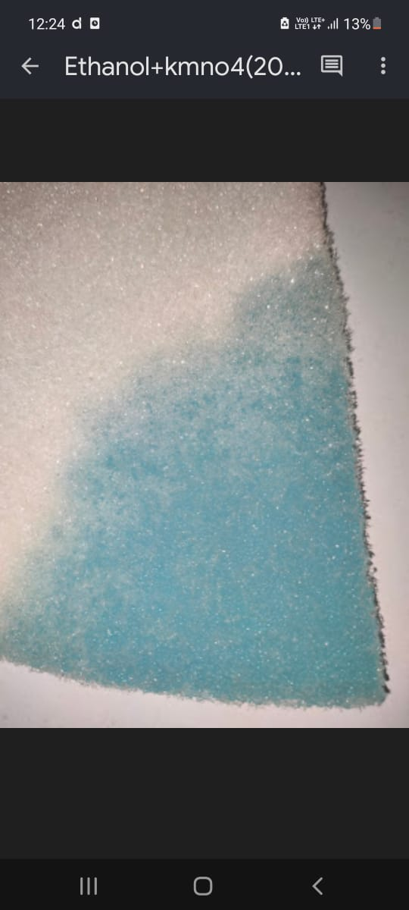
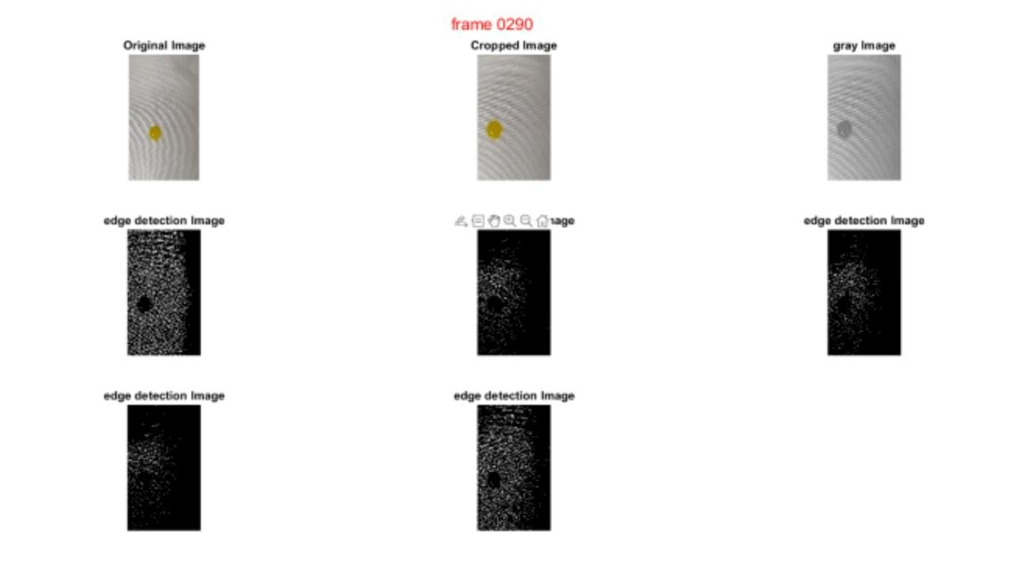
SURGE-2023
Viscous fingering in porous media
SAHIL KENIL GALA,
DEPARTMENT OF MECHANICAL ENGINEERING, IIT KANPUR
RAM JEE SHARMA
DEPARTMENT OF MECHANICAL ENGINEERING, IIEST SHIBPUR
PROFESSOR SHYAM SUNDAR GOPALKRISHNAN
DEPARTMENT OF MECHANICAL ENGINEERING, IIT KANPUR
Objectives of the work
When two fluids with different viscosities encounter each other in a porous medium, the interface separating the two destabilises under certain conditions. This arises due to the difference in the mobilities of the species present in both the liquids. Specifically, the interface destabilises when the injected fluid has a lower viscosity than the fluid present in the porous medium. This phenomenon known as viscous fingereing finds its applications in several engineering disciplines, from oil recovery to ground water sedimentation. In the present study we investigate this phenomenon by injecting a fluid with different viscosities in a porous medium filled with air.
The experiment allows for the observation of the chemical-surface interactions. Different chemicals may exhibit varying degrees of interaction with the surface(cotton cloth is used), affecting their spreading behaviour.
Apparatus
Edge detection images- drop experiment
In the present study we have carried out experiments while using a cloth. A white porous cloth acts as a 2 dimmensional interface demonstrating the spread of liquid along the surface.
The cloth was stretched and kept taut so that we can easily capture liquid spread efficiently.
We used dropper to drop the liquid and check its spread.
Observations
Dropping Kcl solution with KMno4 dye on a paper cloth.
A variety of experiments were conducted by mixing liquids and dyes in appropriate proportions and video was recorded for each spreading phenomenon.
These were the experiments on which processing was done.
The video was processed using image processing in matlab.
The MATLAB code is used for extracting frames from a video and performing various image processing operations on each frame. Overall, the code reads a video, extracts frames, performs image processing operations (cropping, grayscale conversion, and edge detection) on each frame, and visualizes the results. The processed images are then saved for further analysis or visualization.
We also tried to implement viscous fingering algorithms where we dropped liquid and dye mixture over gylcerine. The processed videos along with time rate would allow us to compute difference in viscousity between the liquids.
We also tried 2 ways of dropping liquid on the surface of cloth- one was dropping the liquid from a height and other was injecting liquid on the surface.
Solution | Dye | Surface used
Nacl in 100 ml wter | Kmno4 | Paper cloth
Nacl in 100 ml wter | kmno4 | Glycerine
Ethanol 25 ml | Methylene blue | Paper cloth
Ethanol 25 ml | Methylene blue | Glycerine
Sucrose 25 ml | Methyl orange | Paper cloth
Sucrose 25 ml | Red | Paper cloth
Sucrose 25 ml | red | Glycerine
Ethanol 25 ml | Malachite green | Paper cloth
Sucrose in 25ml | Tatrazine | Paper cloth
Sucrose in 25ml | Tatrazine | Paper cloth
Sucrose in 25ml | Tatrazine | Glycerine
Sucrose in 25ml | Tatrazine | Glycerine
Kcl in 100 ml | Kmno4 | Paper cloth
Kcl in 100 ml | Kmno4 | Paper cloth
Kcl in 100 ml | Kmno4 | Glycerine
Kcl in 100 ml | Kmno4 | Glycerine
Ethanol 50 ml | Malachite green | Paper cloth
Ethanol 50 ml | Malachite green | Paper cloth
Ethanol 50 ml | Malachite green | glycerine
Ethanol 50 ml | Malachite green | glycerine
Studying viscous fingering using sponge- checking flow of liquid through two dimensional porous media.
Conclusions
Spreading over porous substrates occurs in several processes including printing, cleaning, coating, and manufacturing of ceramic structures. For small drops, viscous and capillary forces are ultimately the predominant forces. The process typically undergoes three phases: a first stage in which the droplet spreads, a second phase in which the area of contact with the solid substrate nearly remains constant, and a third stage in which the droplet retracts with its volume reaching zero finally. The objective of the investigation is to find the dynamics of spreading and absorption of the droplet using fundamentals while making relevant approximations to account for both radial and vertical dynamics.
Further plans are to compute rate of change of area with time
Edge detection images- drop experiment
The conclusions drawn from this experiments can provide valuable insights into the behaviour of different chemicals on a surface can be used for various real applications, such as:
Understanding the wetting behaviour and spreading rates of different chemicals can aid in the development of better surface coatings and adhesives. By selecting chemicals with favourable spreading rates, manufacturers can improve coating quality, enhance adhesion between materials, and optimize processes.
Above Analysis can contribute to the development of new materials, surface treatments, and functional coatings.
The diffusion of drugs in the human body plays a vital role in their effectiveness. By studying the diffusion of dyes in different liquids, researchers can gain insights into the behaviour of drugs in various bodily fluids, leading to improved drug delivery systems.
The understanding of the spreading rates and behaviour of different chemicals can be applied in chemical engineering processes. It can help optimize processes such as mixing, dispersion, and reaction rates, leading to improved efficiency and product quality.
Dropping sugar solution mixed with tartazine dye on glycerine

